Slide 1
Welcome to the world of
HHR PPT Presentation

Slide 2
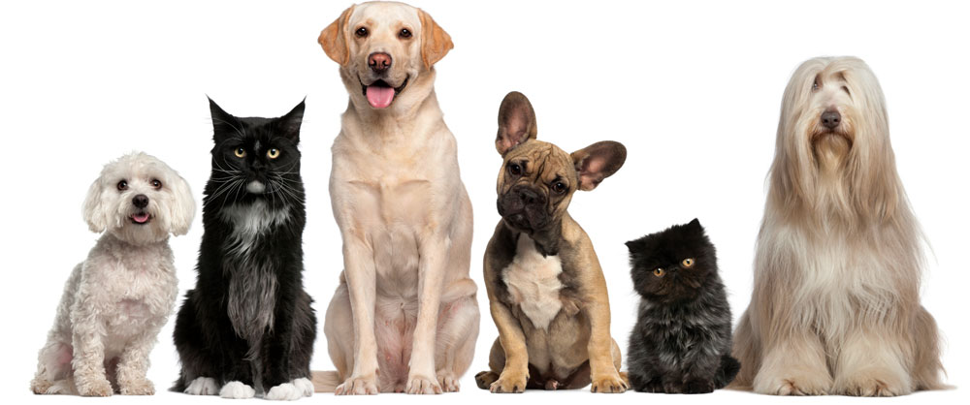
Tell me what is the video about?

Slide 3
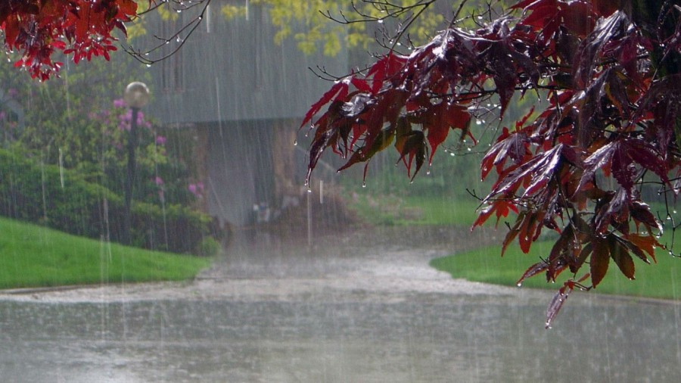
Our today’s lesson is—
Idioms & Phrase
Class VIII-X
It is raining cats and dogs.
What is ‘cats and dogs?’
Idioms and phrase
Notes:
Showing the picture you may ask the phrase then show the other accordingly.

Slide 4
Learning outcomes
After studied this lesson we will be able to---
differentiate the simple and idiomatic meaning of the phrases
make sentences with idioms and phrase
Notes:
Speaking and writing skills will be focused.

Slide 5
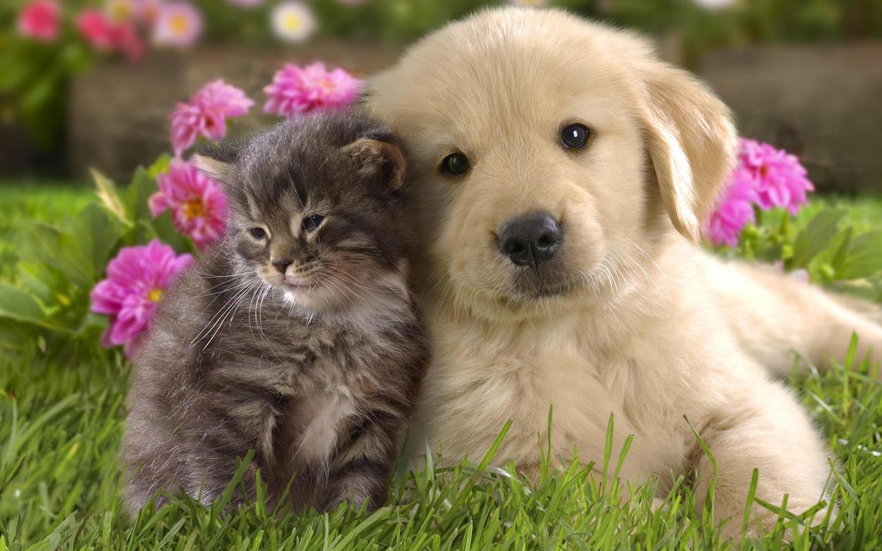
 | Simple meaning | Idiomatic meaning
 | Pets and pups | Heavy rain
Cats and dogs
It has been raining cats and dogs for two hours.
Notes:
Showing the picture you may ask the phrase then show the other accordingly.

Slide 6
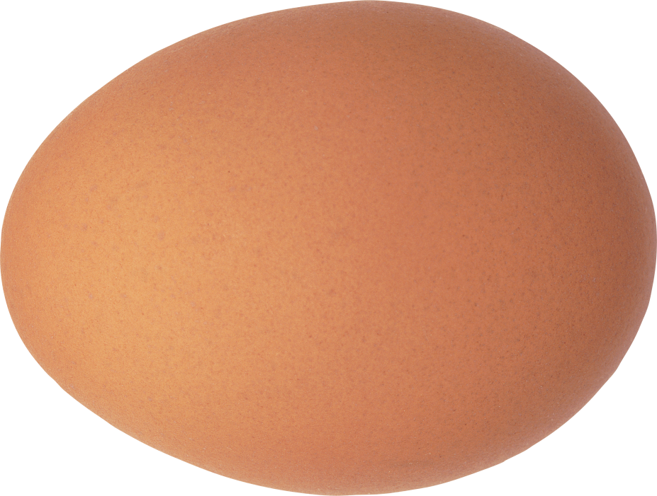
 | Simple meaning | Idiomatic meaning
 | Head of the egg | intelligent/ studious
Egg head
It has been possible because of his egg head.
Notes:
Showing the picture you may ask the phrase then show the other accordingly.

Slide 7
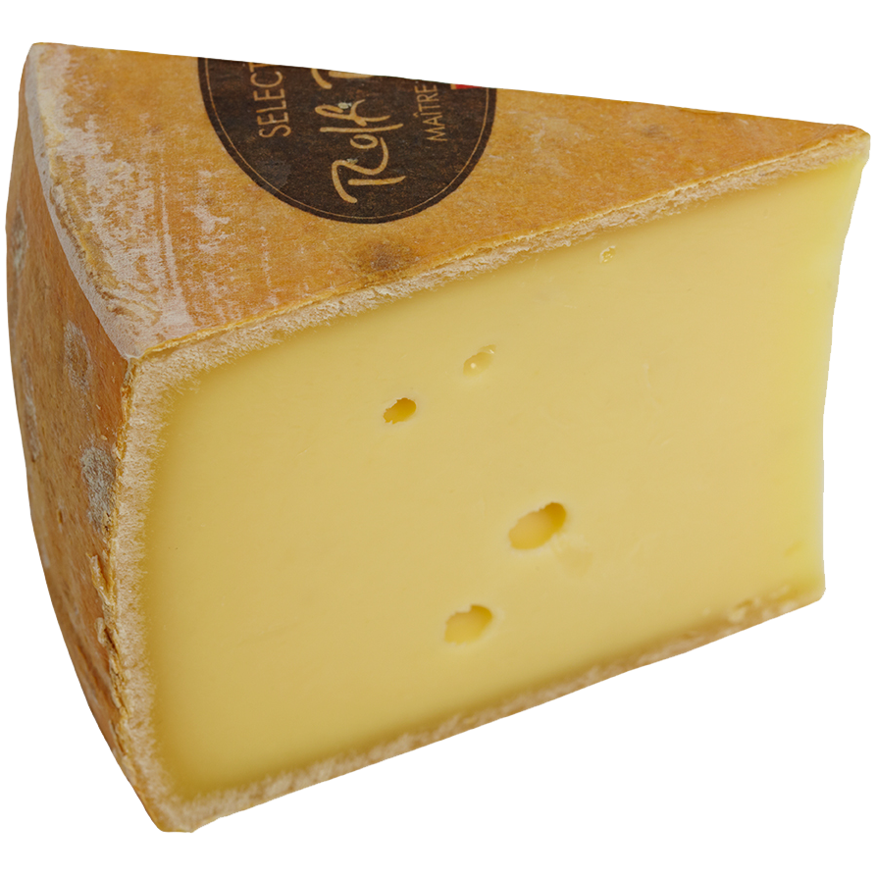
 | Simple meaning | Idiomatic meaning
 | One kind of food in big size made by curd | influential
Big cheese
No one can do any harm to him as he is a big cheese.
Notes:
Showing the picture you may ask the phrase then show the other accordingly.

Slide 8
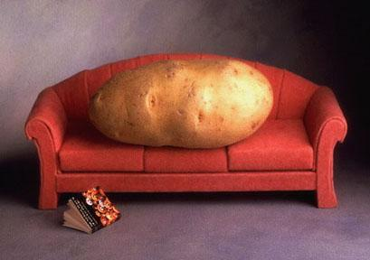
 | Simple meaning | Idiomatic meaning
 | bed pots | lazy person
Couch Potato
He passes his times watching TV as he is a couch potato.
Notes:
Showing the picture you may ask the phrase then show the other accordingly.

Slide 9
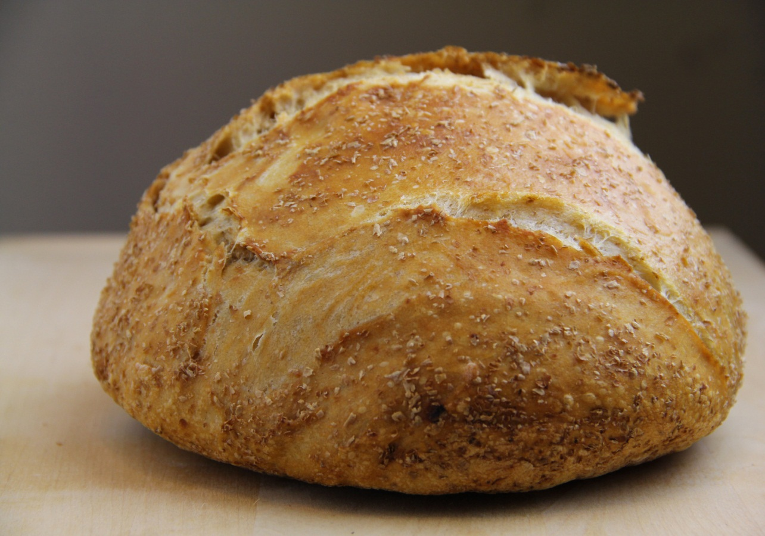
Tough cookie | Simple meaning | Idiomatic meaning
 | hard sweet bread | determined
If you are a tough cookie, your success is a must.
Notes:
Showing the picture you may ask the phrase then show the other accordingly.

Slide 10
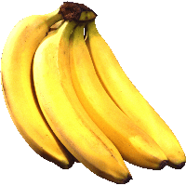
 | Simple meaning | Idiomatic meaning
 | a banana of the top position | leader
Top banana
It is very difficult to meet him because he is now a top banana.
Notes:
Showing the picture you may ask the phrase then show the other accordingly.

Slide 11
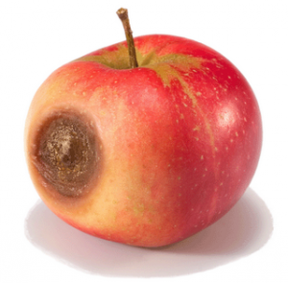
 | Simple meaning | Idiomatic meaning
 | damaged apple | criminal
Bad apple
He can do such a crime because he is a bad apple.
Notes:
Showing the picture you may ask the phrase then show the other accordingly.

Slide 12
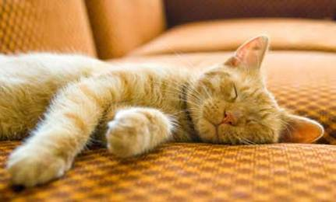
 | Simple meaning | Idiomatic meaning
 | a cat sleeping | act of sleeping
Cat’s sleep
Actually he is hearing everything in cat’s sleep.
Notes:
Showing the picture you may ask the phrase then show the other accordingly.

Slide 13
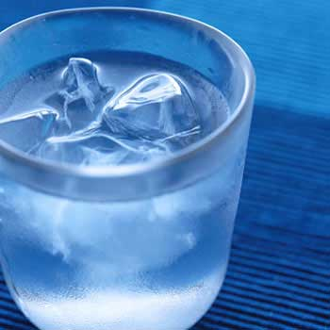
 | Simple meaning | Idiomatic meaning
 | the water that which is very cold | demoralize
Cold water
Please don’t through cold water on his doing this noble job.
Notes:
Showing the picture you may ask the phrase then show the other accordingly.

Slide 14
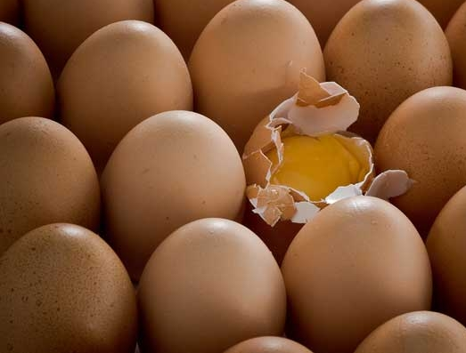
 | Simple meaning | Idiomatic meaning
 | damaged egg | characterless
A bad egg
All hate him because he is a bad egg.

Slide 15
Open your grammar book and find out the meaning of the phrases to make five sentences individually.
Face to face | (a)
At dead of night | (b)
Bad blood | (c)
Cat’s paw | (d)
Eye to eye | (e)
Notes:
Evaluation option.

Slide 16
Home work
Make sentences with the following idioms and phrases.
Above all. By all means, Carry out, Say by day, Fall of
Notes:
Home assignment to be performed at home.

Slide 17
May Allah bless you.
Notes:
Ending slide.

